Slide 1
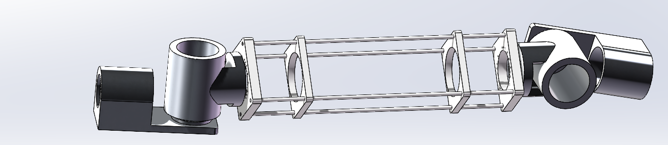
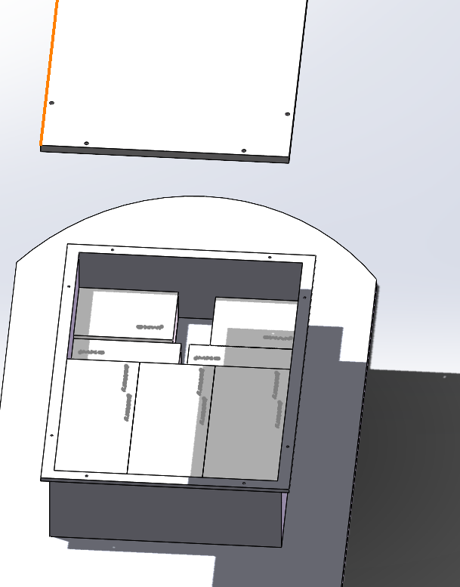
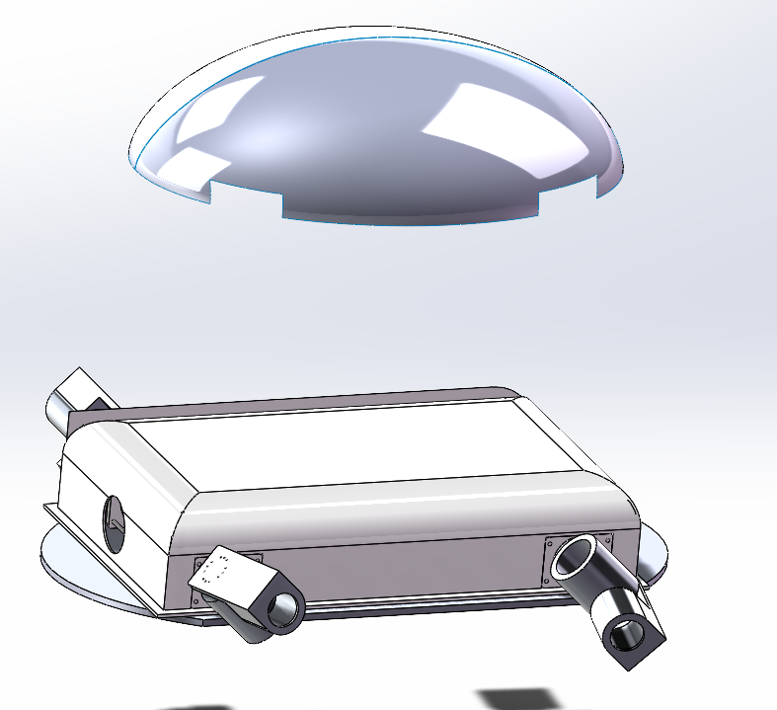
Cavity
Cavity design
1.The chips and batteries are placed as follows.
2.Secure the arm with an aluminum rod.

Slide 2
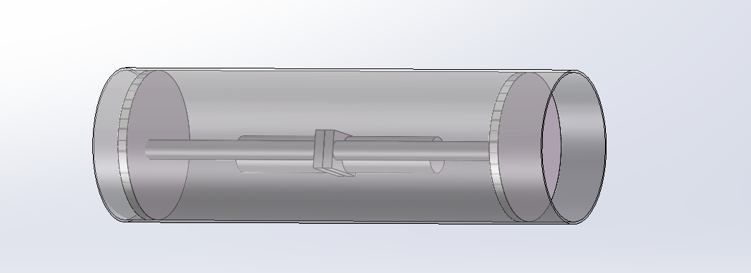
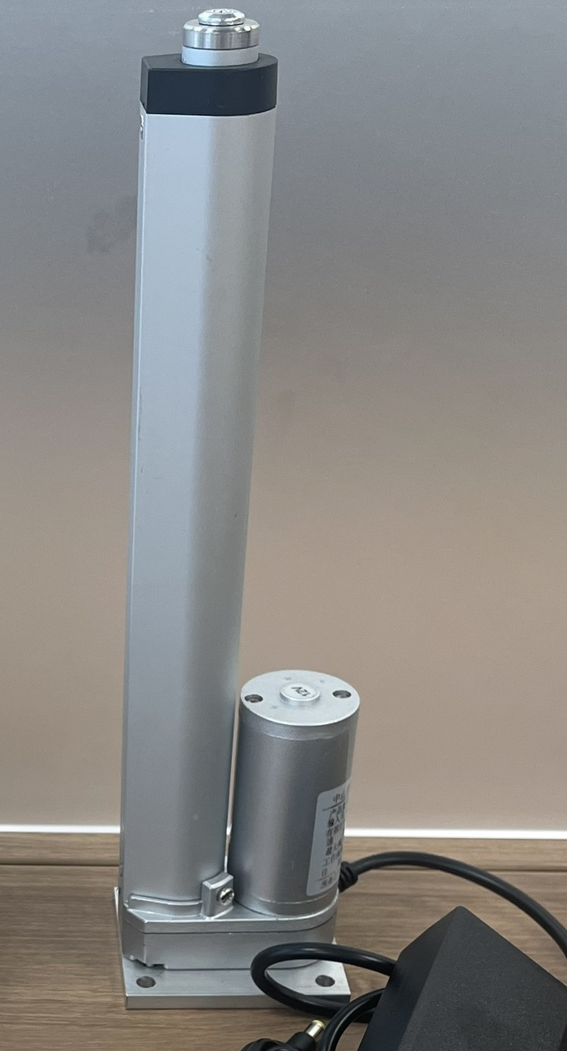
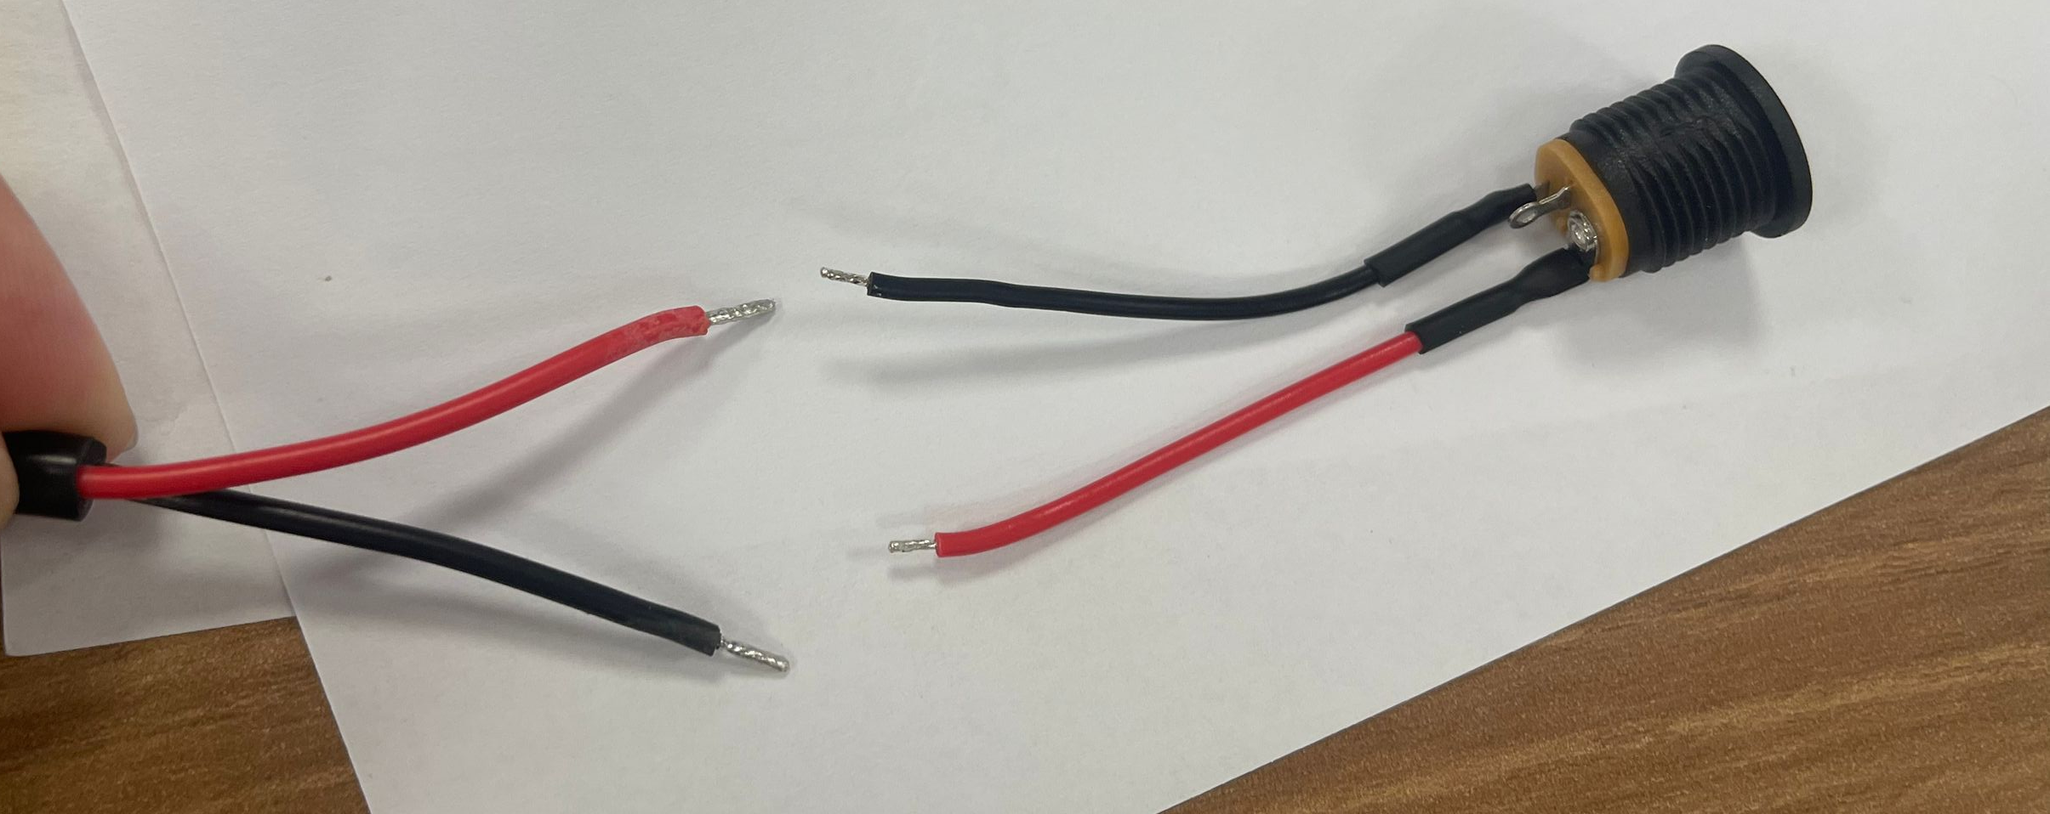
Cavity
Piston jack buoyant device design

Slide 3
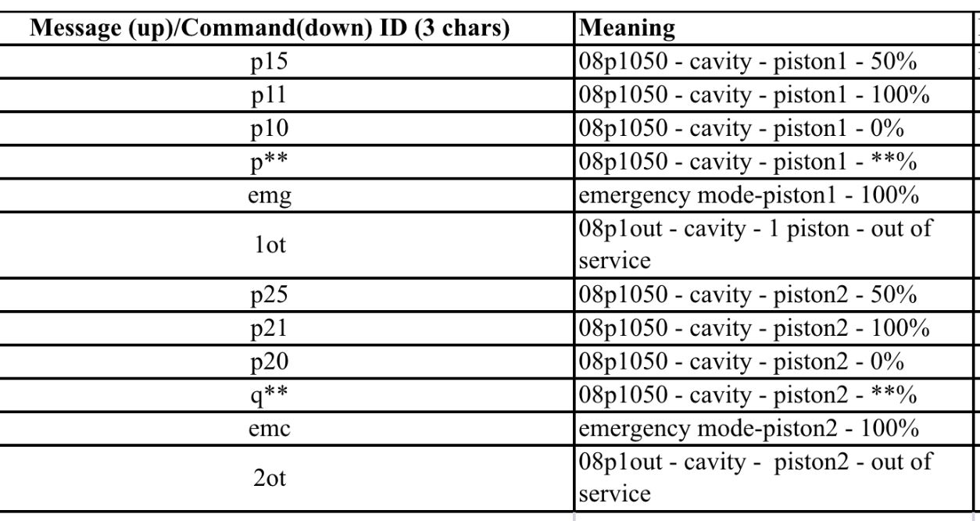
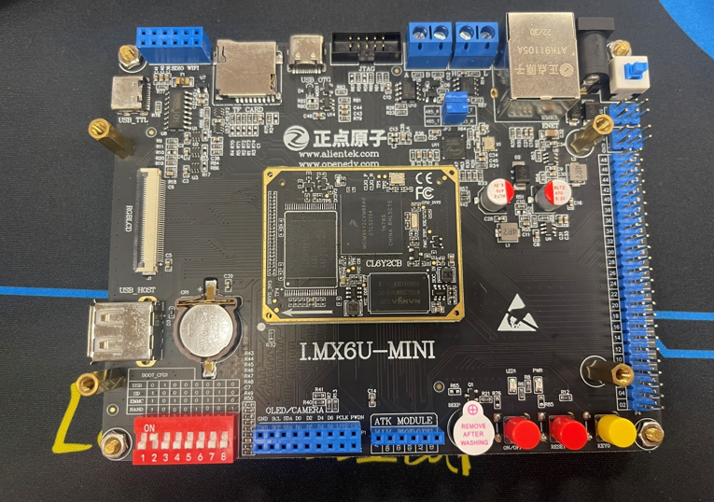
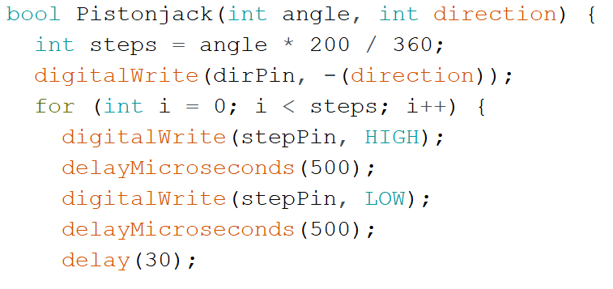
Cavity
Piston jack drive code design
Build the IMX6 board environment and control the jacks on the board

Slide 4
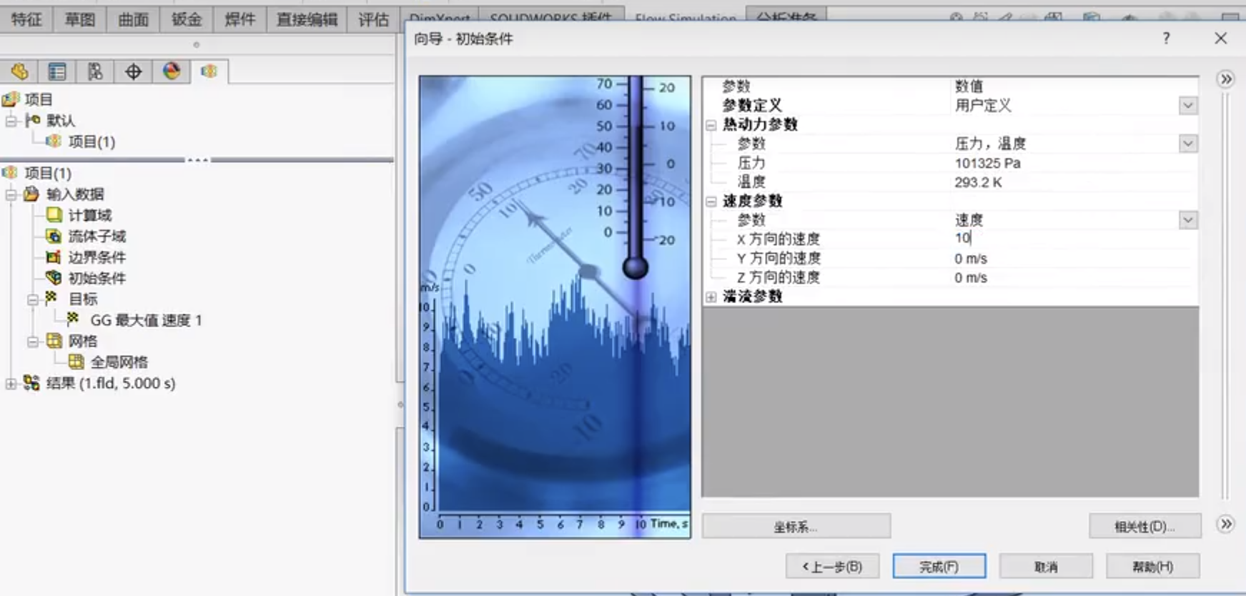
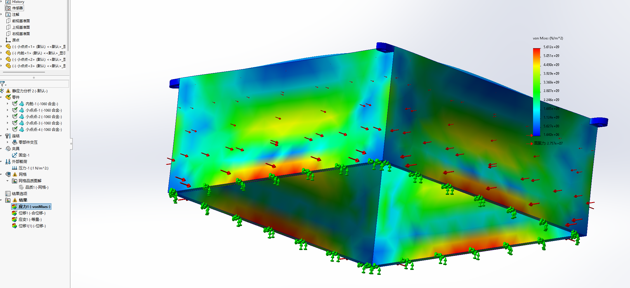
Cavity
Reduced water friction
Testing Water Friction with SolidWorks Flow Simulation
Simulate underwater

Slide 5
Cavity
Next steps:
1) Finish the cavity with all the fixings for the arms and the neck
2) Fixation of chips and batteries to the inner cavity
3) Complete all control codes for the piston airbag
4) Completion of the waterproof design according to the needs of the cavity
5) Simulation of pressure analysis and friction analysis of an cavity underwater

